Slide 1
Energy Efficiency for IoT Software in the Large
Francisco Sant’Anna
UERJ

Slide 2

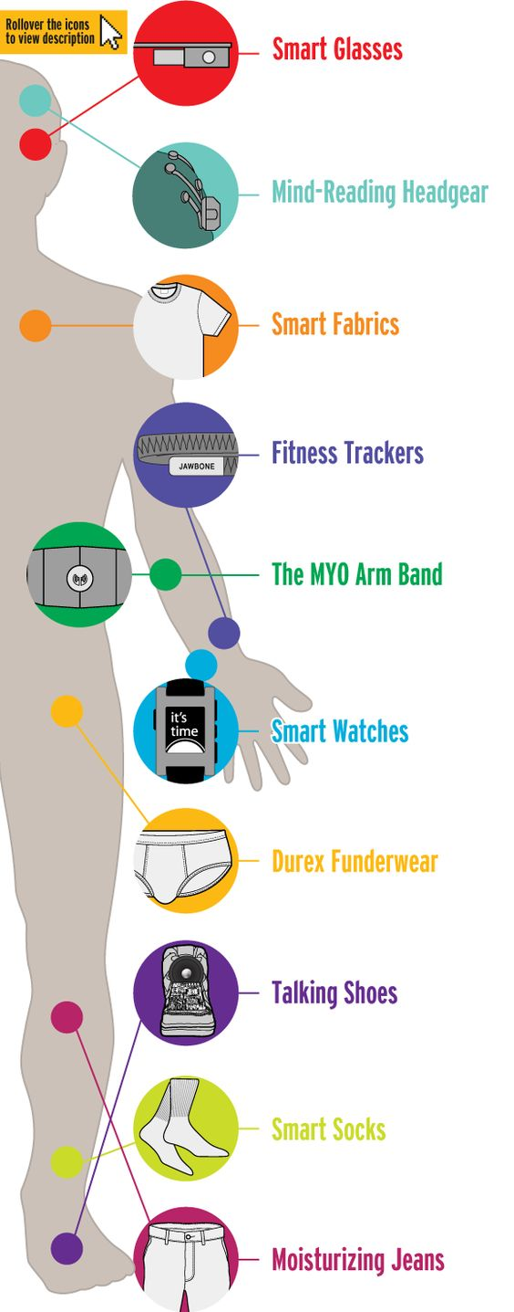
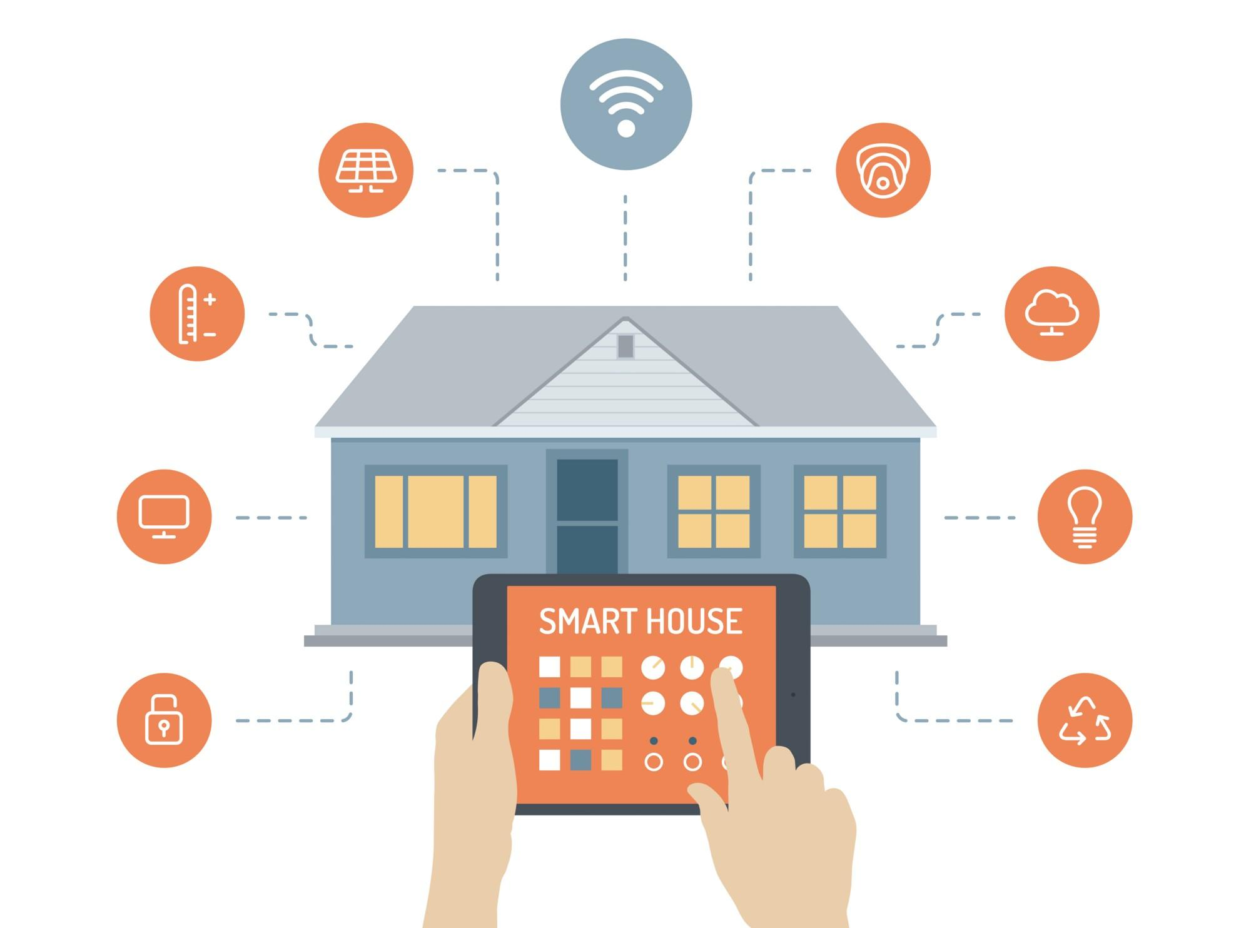
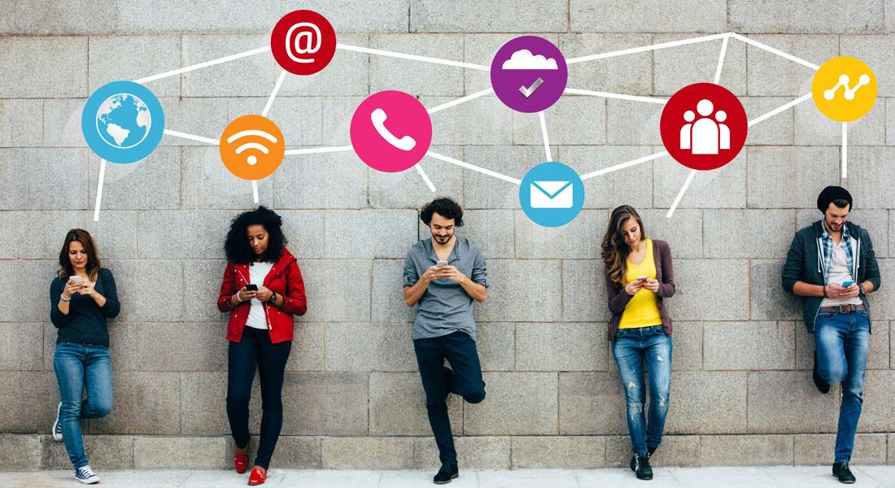
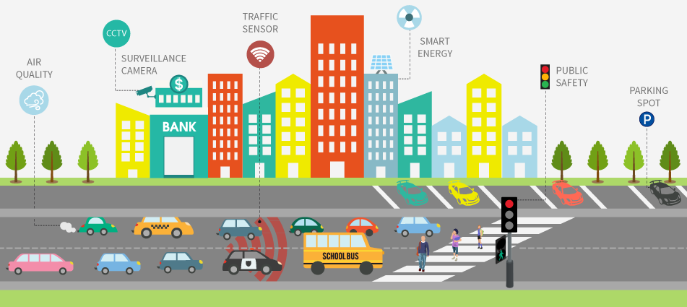
From “Traditional Internet” to the “Internet of Things”
Today: 15 billion traditional devices
Tomorrow: 50 billion IoT devices (2020)

Slide 3

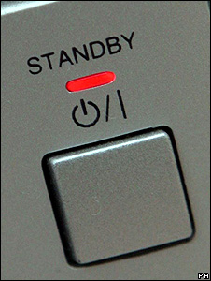
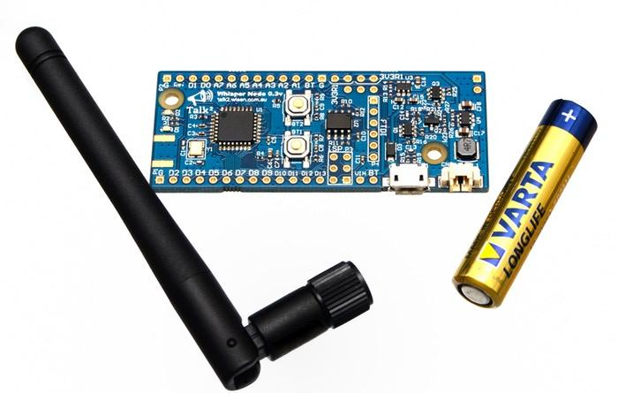
Energy Efficiency for the IoT
Challenges: Pollution and Autonomy
Opportunities: Effective use of “standby”
30-50% economy with existing technologies

Slide 4
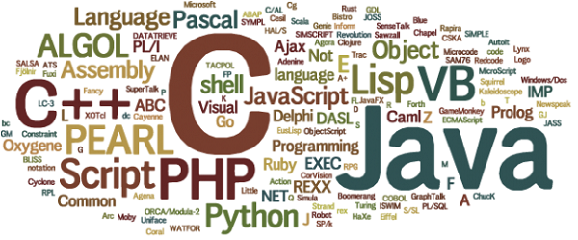

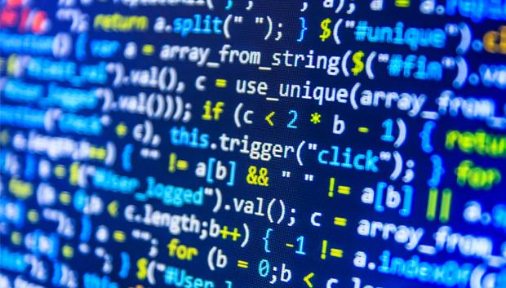

Céu: An Energy-Aware Programming Language
All smart devices have software...
… and all software is written in a programming language
But current programming languages were not designed with energy efficiency in mind!

Slide 5





But what really is a Programming Language?
A computer is programmable,
but how?

Slide 6




But what really is a Programming Language?
Machine Language
The Compiler (or Interpreter)
The Language
every 10s do
readSensor();
transmitMsg();
end
Design
and Implementation

Slide 7
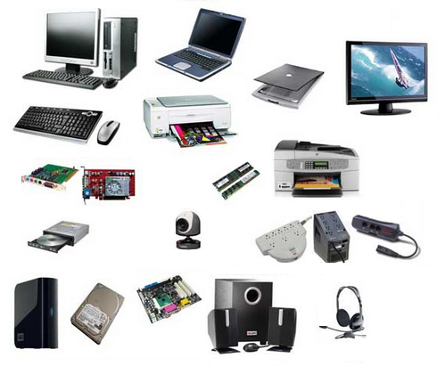
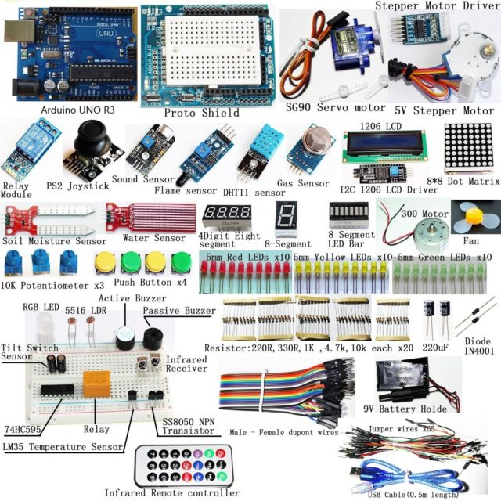
Current languages were not designed with energy efficiency in mind...
...and neither with the surrounding physical world in mind.
Most energy is consumed by peripherals!
computer
peripherals
IoT sensors
& actuators

Slide 9
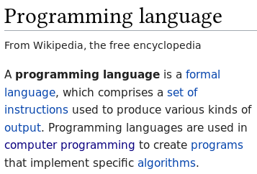
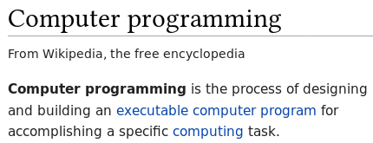
But what really is a Programming Language?

